Slide 1
North Lynden Area
Stormwater and Drainage Management
April 21, 2009
North Lynden Watershed Improvement District
∙ Interjurisdictional Meeting

Slide 2
Welcome & Objectives
Provide governments working in the Fishtrap Watershed
Overview on current flood water conveyance and drainage in Northern Whatcom County.
Update on 15-20 year holistic approaches to improving flood flow and water conveyance in the North Lynden area of Whatcom County.
Opportunity to explore projects that advance long term solutions to flood concerns.
Notes:
Provide governments working… does this first line make sense?

Slide 3
Introductions
Fishtrap Watershed Improvement District
Formed in November 2007 by majority of landowners who own parcels 3.o acres or larger within North Lynden Watershed Improvement District area.
We are an Irrigation District-Chapter 87.03 RCW.
Introductions of other government entities working in the Fishtrap Creek Watershed.

Slide 4
Study Area

Slide 5
Fishtrap Creek Watershed Characterization
What do we know about this watershed ?
Joanne Greenberg, HydroLogic Services

Slide 6
Current pathways for flood waters in the Fishtrap Watershed
Modeled Subbasins on the right show the creek and drainage system in the Fishtrap Creek Watershed.
Source: HydroLogic Services
2008 Fishtrap Watershed Characterization
Notes:
SPEAKING POINT: HydroLogic Services and SilverTip Solutions refined the WRIA1 TOPNET model to better reflect local conditions of Fishtrap Creek. Process included:
- Identified 50 subbasins of areas contributing
To the International Border between US and Canada
To main intersections of Pangborn and Badger Roads
- Calibrated model to the streamflow gages
Fishtrap Creek at the border
Fishtrap Creek at Front Street
Pepin Creek – seasonal gage only
OUTPUT of the Model over predicts at border and under predicts at Front St.

Slide 7
Annual Hydrograph
Fishtrap Creek at Front Street
Water Year 2005

Slide 8
Fishtrap Creek at Front Street
- January of Water Year 2005

Slide 9
Subbasin | Average Annual Precipitation (inches) / mm | Percent of Total Area to Badger Rd
FTC CA | 60.3 inches (1532 mm) | 23%
FTC CA East | 58.0 inches (1473 mm) | 27%
Pepin | 59.9 inches (1521 mm) | 17%
FTC US | 49.9 inches (1267 mm) | 12%

Slide 10
Channel Capacities
Location | Conveyance System | Existing Capacity (cfs) | Design Flow for 25-year Return Period (cfs) | Percent of Capacity
North of Badger to Border | Double Ditch East | 56 | 100 | 179%
 | Double Ditch West | 51 | 100 | 196%
North of Pangborn to Visser | Benson Rd | 154 | 74 | 48%
North of Pangborn to Border | Depot | 101 | 83 | 82%
 | Bender | 178 | 77 | 43%
North of Badger to Pangborn | Benson Rd | 226 | 101 | 45%
 | Depot | 99 | 98 | 99%
 | Bender | 254 | 267 | 105%
Assink Rd W/N of Pangborn & Fishtrap Cr Junction |  | 1308 | 2920 | 223%
*based on annual maximum of average daily flows

Slide 11
Culvert Capacities
Location | Conveyance System | Estimated Culvert Capacity When Flowing Full (cfs) | Design Flow For 25-year Return Period (cfs) | Percent of Capacity
North of Badger to Border | Double Ditch East | 126 | 100 | 79%
 | Double Ditch West | 126 | 100 | 79%
N of Pangborn To Visser | Benson Rd | 21 | 74 | 352%
North of Pangborn to Border | Depot | 70 | 83 | 119%
 | Bender | 78 | 77 | 99%
North of Badger to Pangborn | Benson Rd | 78 | 101 | 129%
 | Depot | 35 | 98 | 280%
 | Bender | NA | NA
Assink Rd W/N of Pangborn, & Fishtrap Creek Junction |  | NA | NA
NA – not available at this time

Slide 12
Fishtrap Creek Watershed
2008 Characterization
  Key limiting factors for managing
  increased flows:
    The majority of the water comes from Canada
    Conveyance capacity is limiting factor
    Increased water conveyance will flood the
    City of Lynden

Slide 13
An Overview of the Issues
John Gillies, North Lynden WID staff
    Why status quo is no longer advisable
    Endangered Species concerns
    Agricultural impacts
    City of Lynden impacts
    North Lynden WID Initial Plan
    Maintain and improve the existing drainage system

Slide 14
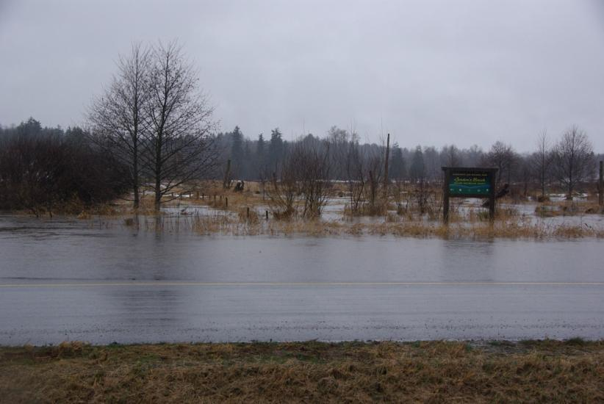
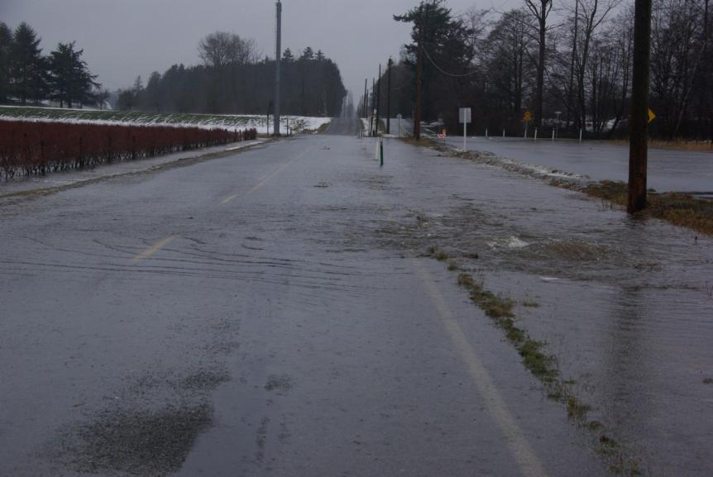
A lot of water coming from north
1
Pepin Brook at Canadian Border
1
Water flowing over Boundary Road

Slide 15
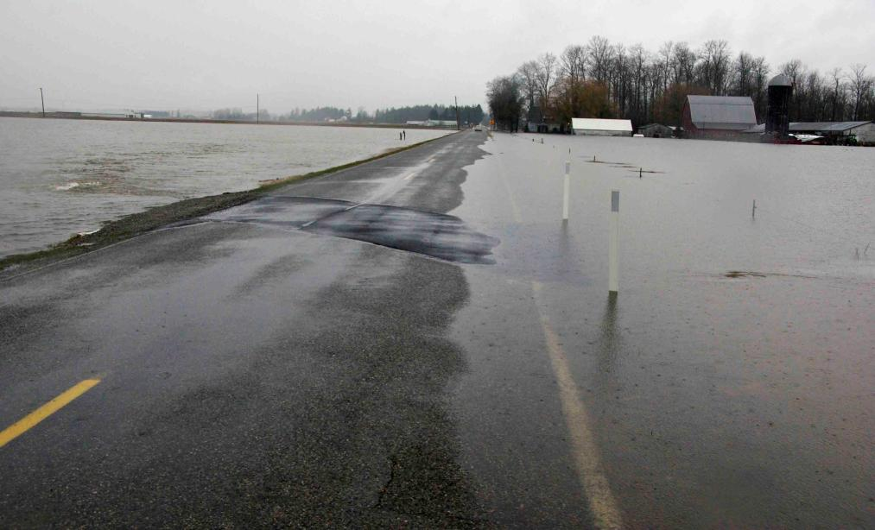
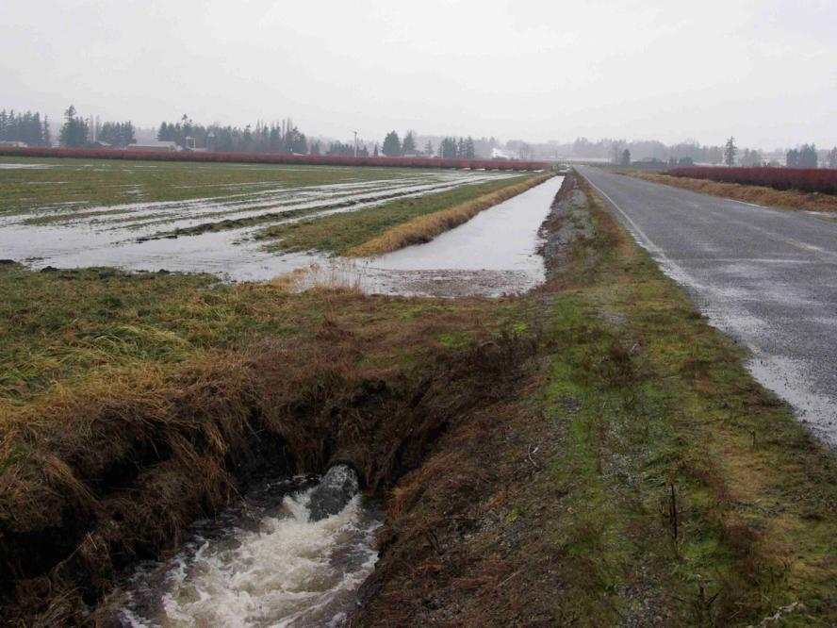
We slow the flow
2
East-west oriented roads, such as Pangborn Road, slow the flow and serve as dikes and weirs.
3
Assink Road ditch is estimated to detain 0.4 acre feet of water per mile.
Notes:
Examples of “forced storage” of storm water in the North Lynden Area. Assink Rd ditch estimated to detain about 0.4 ac-ft per mile. The east-west orientated roads such as Pangborn are more significant at detaining flow. One inch of runoff from watershed is about 2,000 ac-ft. The big storm events produce and estimated 2-3 inches of runoff
15

Slide 16
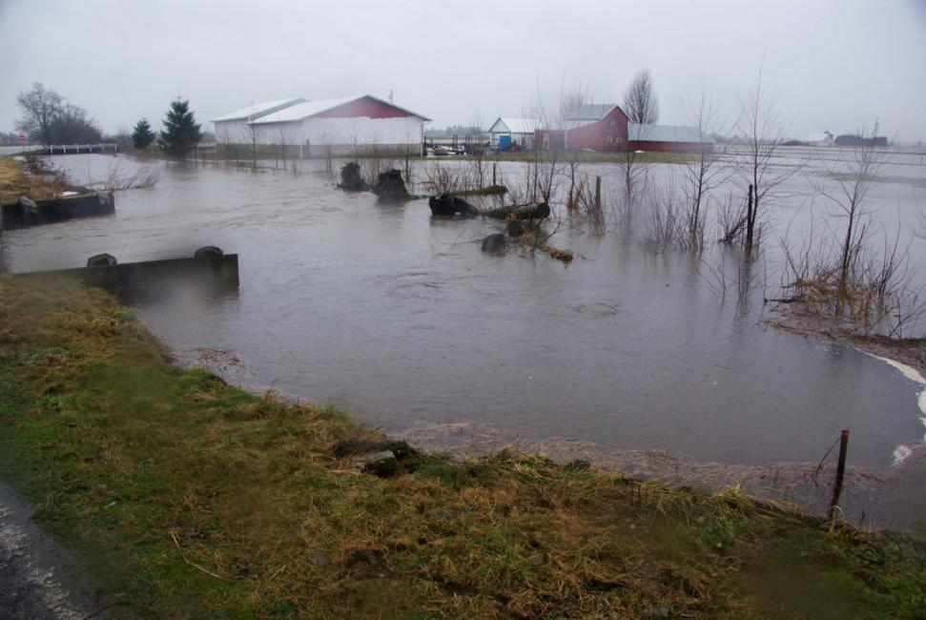
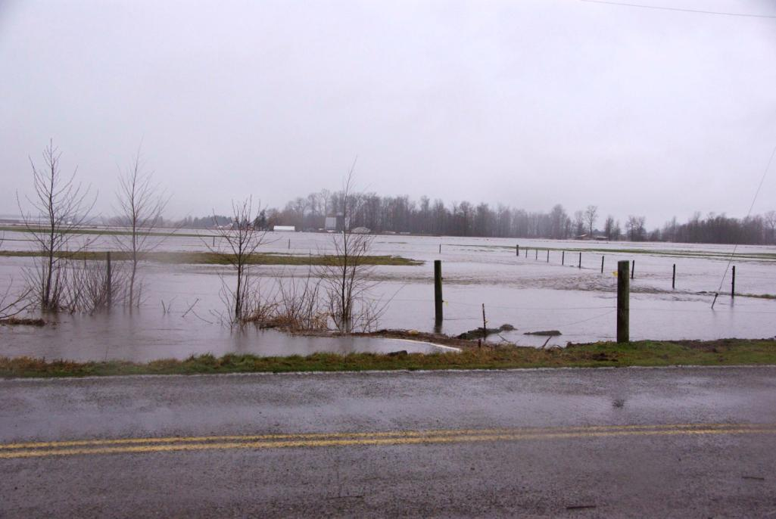
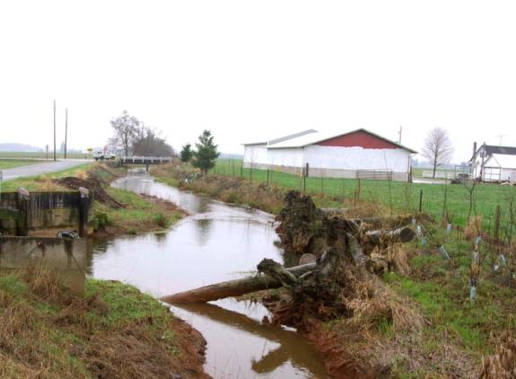
It just keeps on coming…
4
4
4
Notes:
16

Slide 17
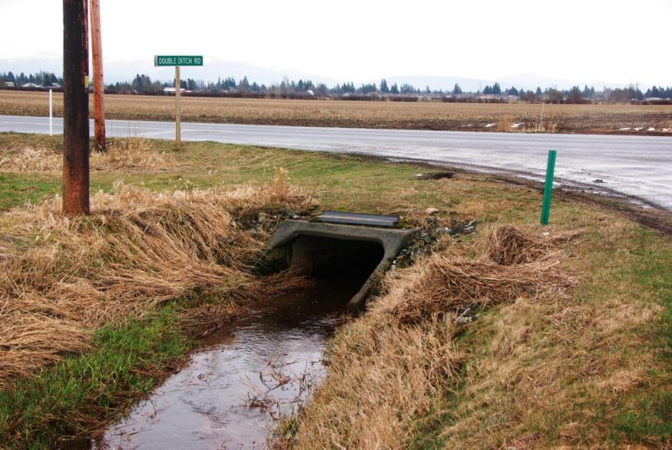
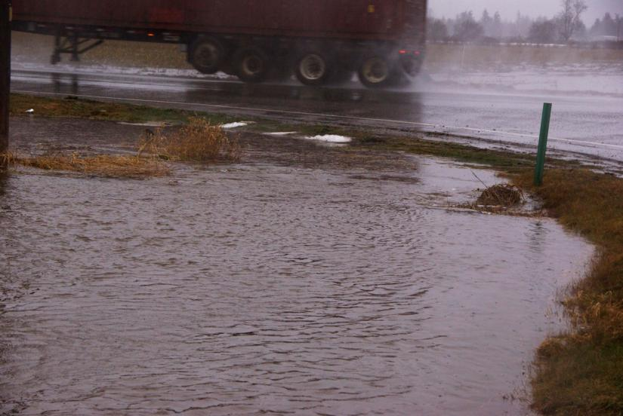
Double Ditch Creek
Same Place – Different Time
5
5
Corner of Double Ditch Road and East Badger Road north of Lynden
Notes:
17

Slide 18
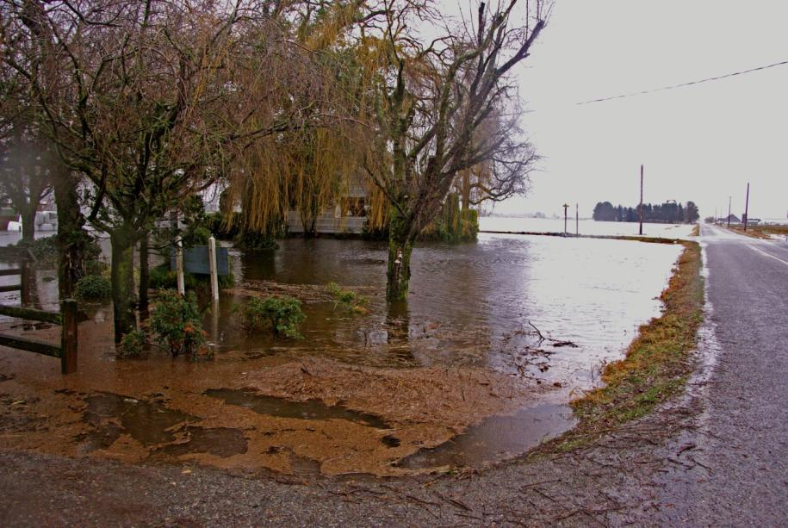
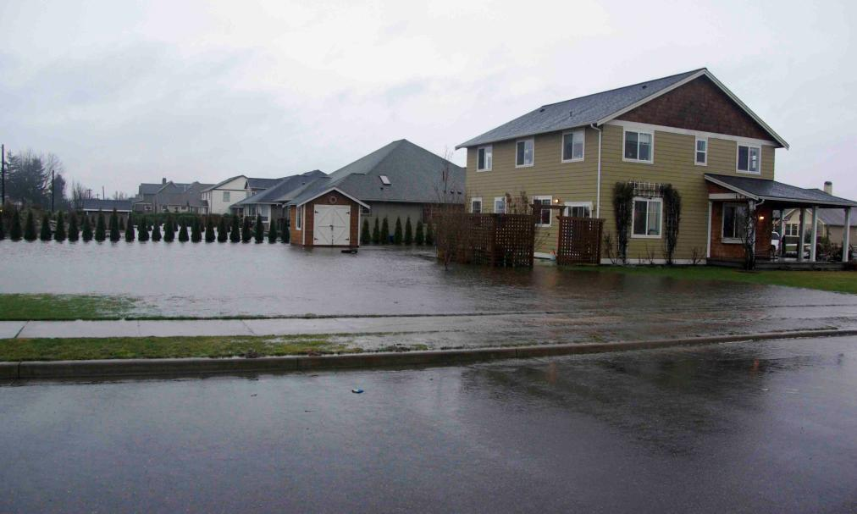
Bender Road & Benson Road
Impacts to residents in Whatcom County & City of Lynden
6
7
Notes:
18

Slide 19
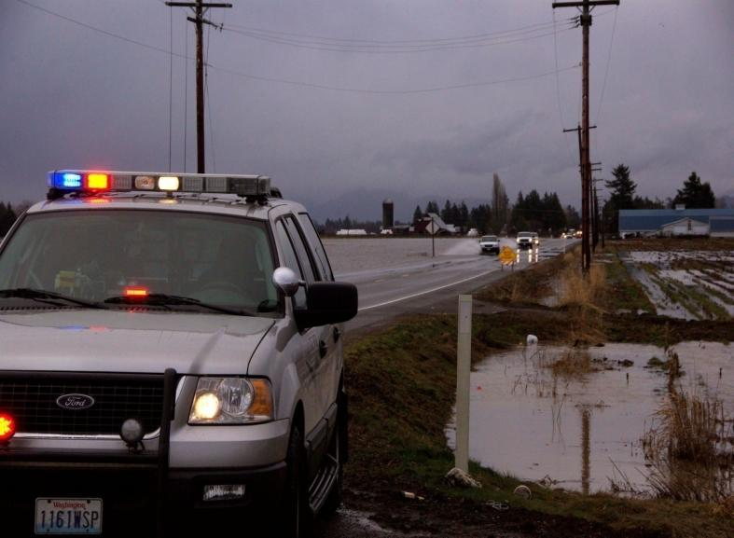
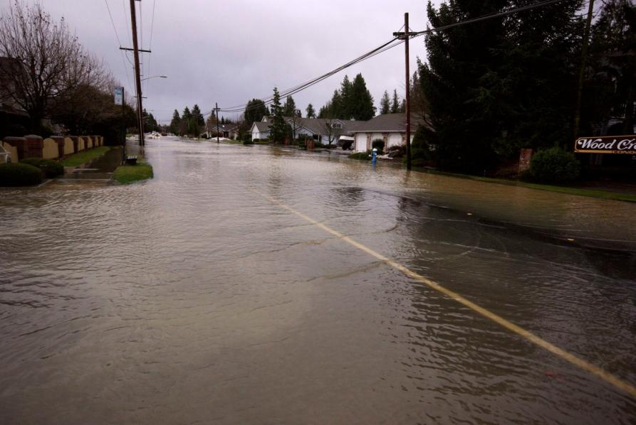
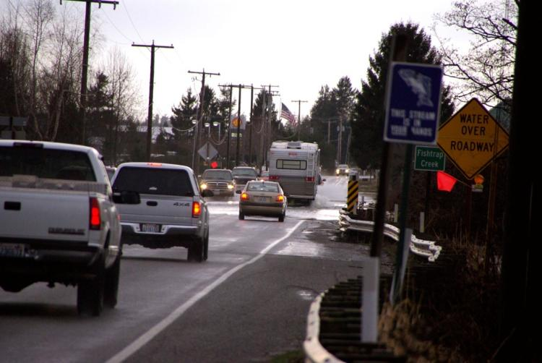
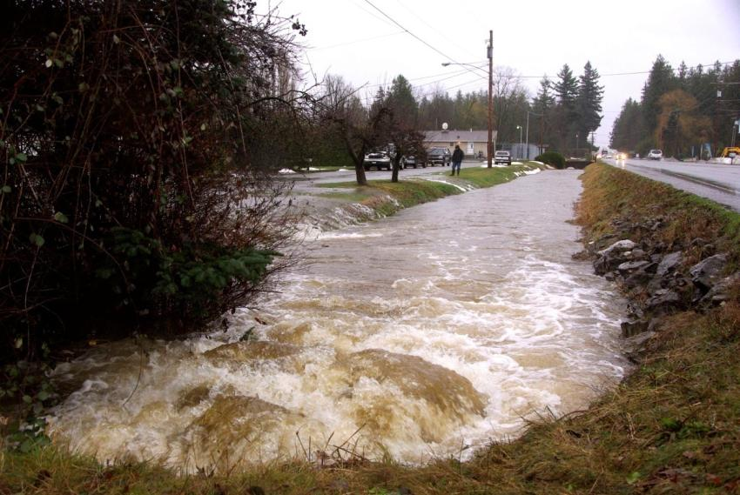
Water moving into and through Lynden
Double Ditch at Badger Road looking east
Main Street and 19th looking east
8
10
Main Street and Guide Meridian
9
Badger Road at Vinup
11
Notes:
19

Slide 20
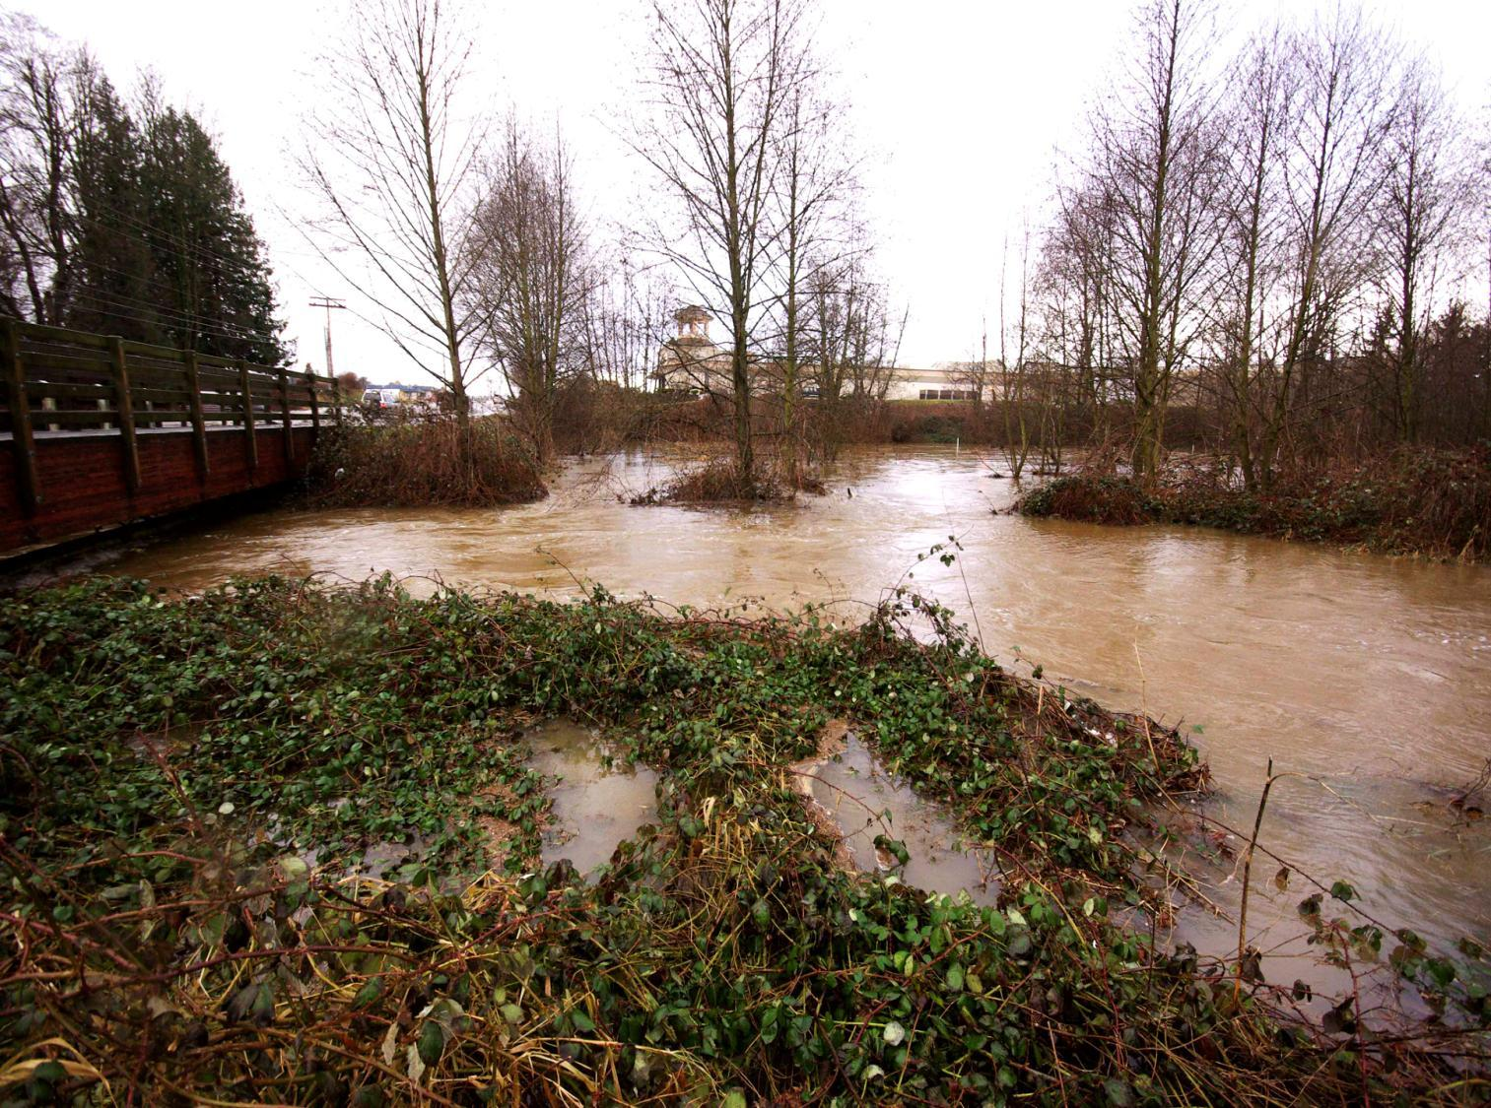
Water exiting the City of Lynden to the Nooksack River…
Fishtrap Creek at Kok Road
12
Notes:
20

Slide 21
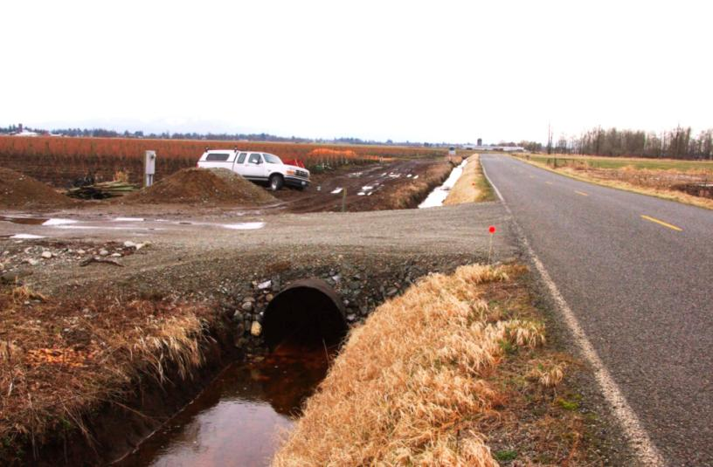
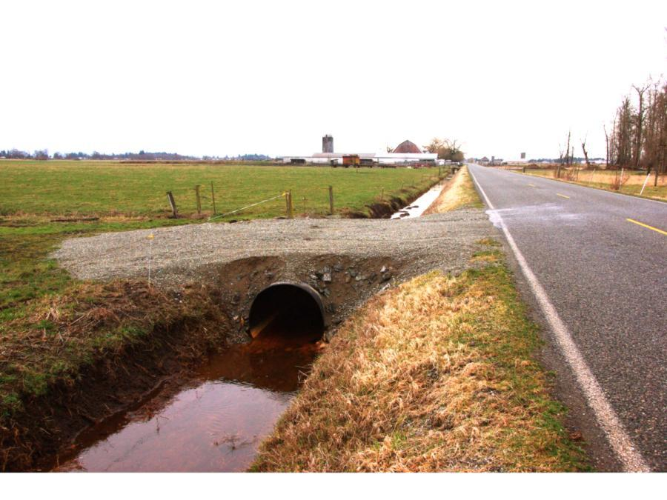
North Lynden WID’s Basic Plan:
Maintain & improve existing infrastructure
13
Culvert upgrades along Bender Rd
14
Notes:
21

Slide 22
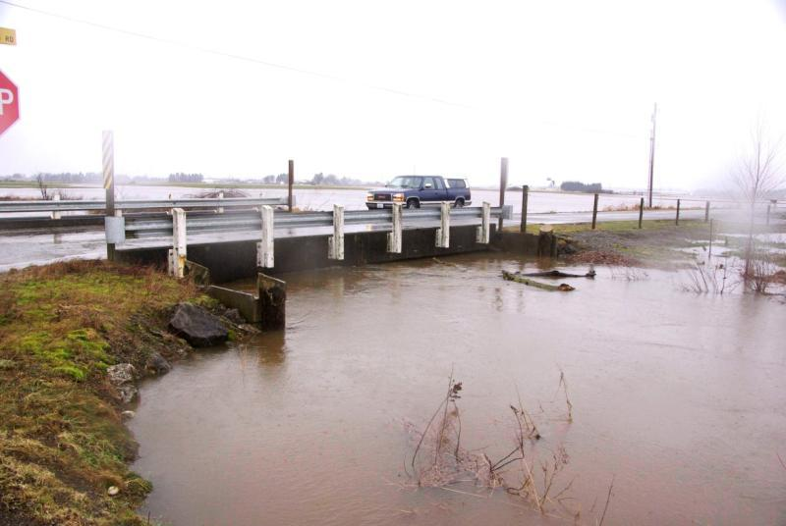
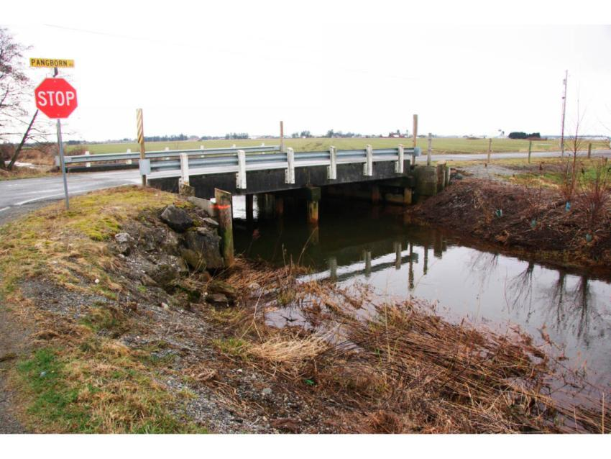
Easier said than done!
15
15
Notes:
22

Slide 23
Stormwater Management:
Solutions Under Consideration
Overview of conceptual approaches
for improving flood capacity and conveyance in the Fishtrap, Benson,
and Double Ditch Creeks.
Dale Buys, Reichhardt & Ebe Engineering

Slide 24
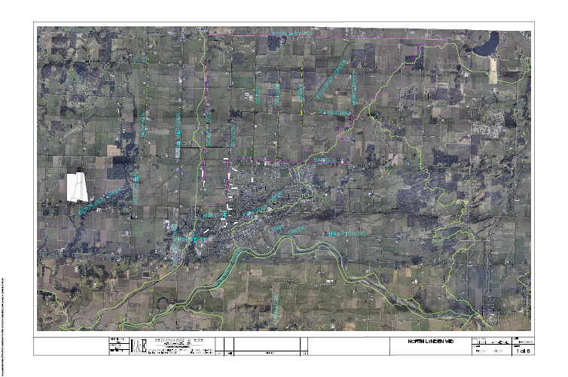
Overview of U.S. Fishtrap Watershed area

Slide 25
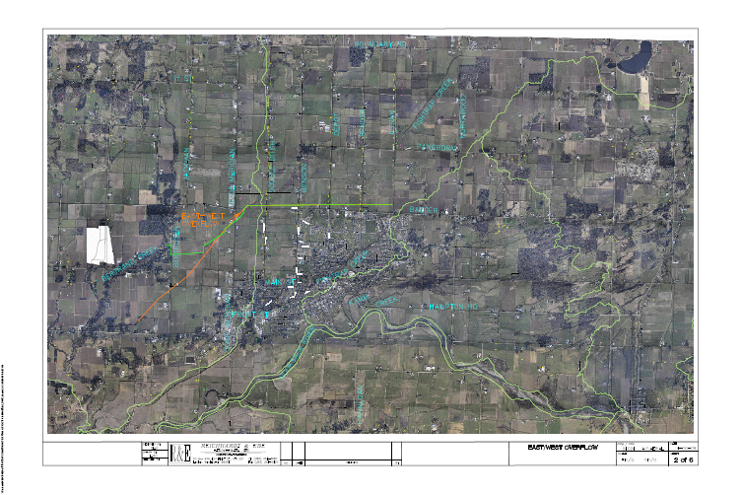
East-West Overflow Project

Slide 26
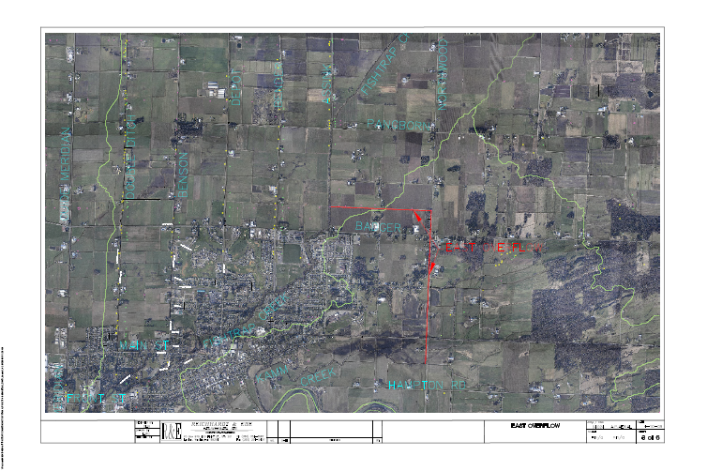
East Overflow to Kamm Creek

Slide 27
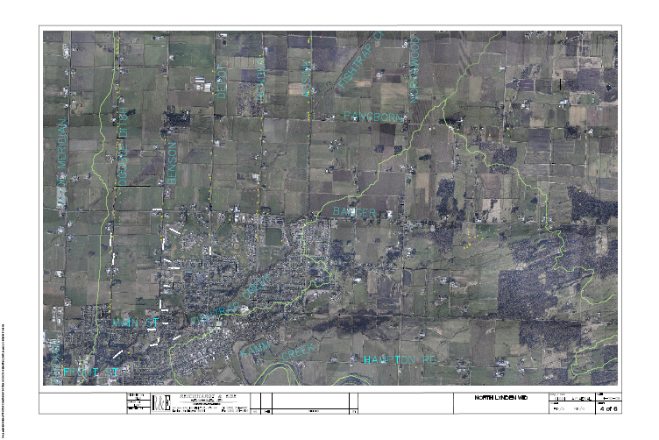
Multiple Minor Improvements

Slide 28
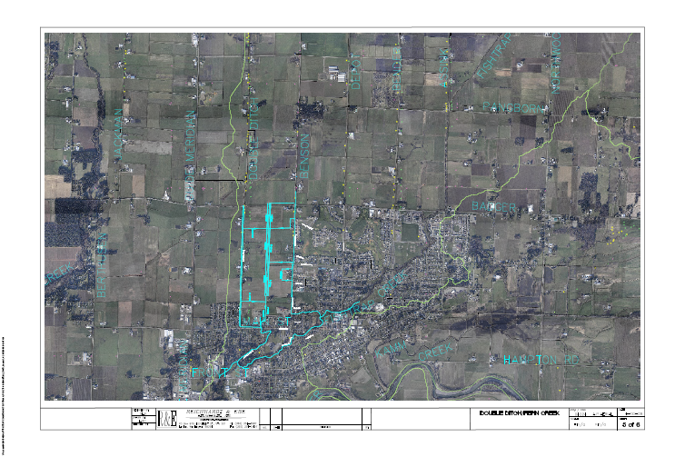
Pepin Creek Improvements

Slide 29
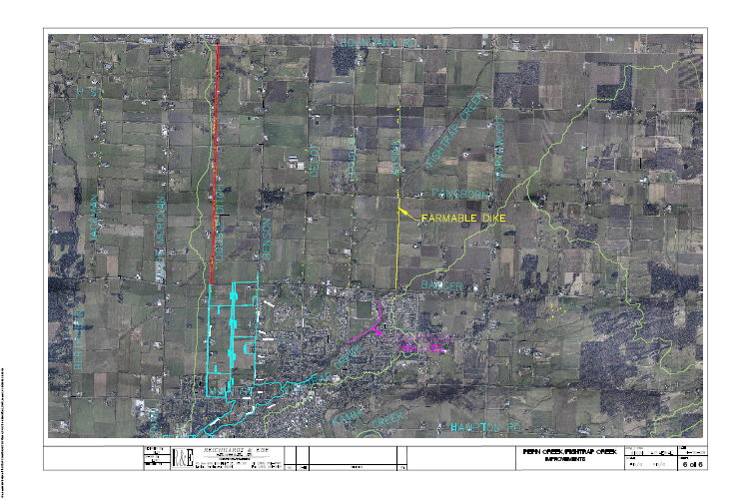
Fishtrap Creek Improvements

Slide 30
Cooperative Management for Holistic Solutions
Rainfall and water
from the north
North Lynden WID lands and infrastructure slow and hold the water
City of Lynden controls the drain

Slide 31
Ideas for Stormwater Management in the Fishtrap Watershed
Casey Lankhaar, Moderator
How do these issues and project concepts relate to your organization’s planning for this watershed?
      City of Lynden
      Whatcom County – Public Works, Flood Control
      Washington Department of Transportation
      Washington Department of Fish and Wildlife
      Washington Department of Ecology
      Drainage Districts and Flood Control Boards
      Canadian Jurisdictions

Slide 32
Ideas for Stormwater Management in the Fishtrap Watershed
What suggestions do you have to advance more holistic solutions?

Slide 33
Thank You and Next Steps
North Lynden WID will identify key concerns and early opportunities to improve conditions AND maximize benefits to all jurisdictions.
Please be sure to sign in so we can send you follow up information on this discussion and next steps.

